Slide 1
Targeted Synthetic BLE Packet Data Generation Approach (Midterm)
16.12.2024
Keisuke Yokota

Slide 2
Executive Summary
Introduction
Background
Index
Design
Implimentation
Next Step

Slide 3



Executive Summary
The Goal
Investigate the usefulness of the Markov model in synthesizing data in BLE packets
Clarify to be a Markov model appropriate for creating BLE data
Create synthesis data of BLE using a Markov model
Evaluate the synthetic data
What I did
Generate synthetic data with the Markov model
Understood the basics of BLE packet structure and synthetic data
Researched related work
Determined which BLE packet data to synthesize
Generated synthetic data with Markov model
What I will do
Evaluate the synthetic data
Compare the structure of data with synthetic data and original data
Compare confidence levels between models with and without synthetic data

Slide 4
Executive Summary
Introduction
Background
Index
Design
Implimentation
Next Step

Slide 5


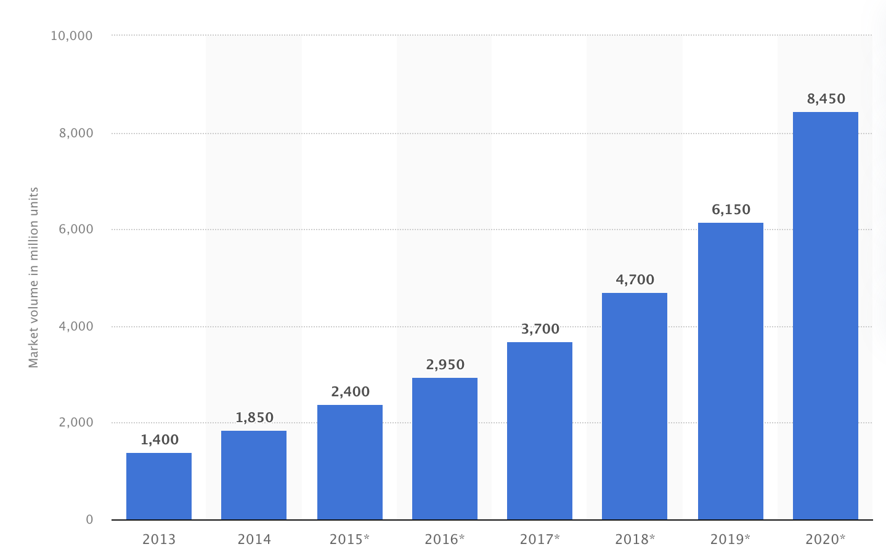

The current state of BLE
BLE devices market volume (in million units)
BLE is abused.
Examples of BLE Abuse
AirTag is slipped into a car to illegally obtain location data (Bern, 2022)
A woman used an AirTag to trach her boyfriend and later killed him (US, 2022)
A woman was stalked by her ex-boyfriend using an AirTag, and she was ultimately shot with a gun. (US 2022)
BLE showed up in the market in 2011 with the iPhone 4s
BLE is used in smartphones, smartwatches, speakers, and personal tracking devices like AirTag.
It is important to develop a model
to detect and classify BLE devices
https://www.statista.com/statistics/750569/worldwide-bluetooth-low-energy-device-market-volume/, https://www.20min.ch/story/ich-hatte-panik-bernerin-19-findet-fremden-airtag-unter-ihrem-beifahrersitz-460234987350, https://www.nzz.ch/panorama/airtag-stalking-hat-apple-die-gefahr-unterschaetzt-ld.1688765?reduced=true
Notes:
BLEデバイスが普及する一方でストーカーに悪用されるなどの問題があり、BLEデバイスを検知し、分類するモデルの必要性が高まる。
BLE devices are becoming popular. However, their misuse by stalkers highlights the growing need for models to detect and classify such devices.
↓AirTagを使用した事件
https://ascii.jp/elem/000/004/219/4219026/

Slide 6




Why generate synthetic data?
Importance of large dataset
Cost and risk
Large Dataset
It may not be possible to extract enough meaningful features with a small dataset.
Time and monetary cost
Collecting large amounts of data is time-consuming and financially costly.
Diverse Dataset
Real-world data contains noise. Diverse data is needed to deal with these noises.
Privacy issues
Data from the BLE device would reveal the user's location.
Synthetic data resolves these problems
Notes:
A large amount of diverse data is needed to create a classification model. However, data collection is costly. Therefore, synthetic data is created.

Slide 7





Research questions
Clarify to be a Markov model appropriate for creating BLE data
Goals
Create synthesis data of BLE using
a Markov model
Evaluate the synthetic data
Notes:
The objective of this research is to generate high-quality synthetic data of BLE packets using the Markov model.

Slide 8
Executive Summary
Introduction
Background
Index
Design
Implimentation
Next Step

Slide 9





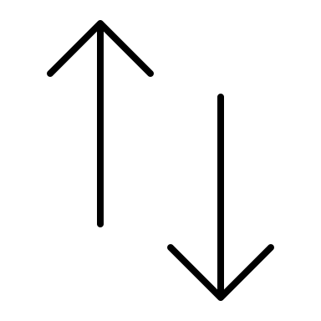
How Does BLE Communicate?
Searching central
One-to-one connection
Advertising
Central
(e.g., iPhone)
one-to-one connection
Periphera (e.g., AirTag)
Notes:
BLEの説明。ペリフェラルとセントラルがあり、相手を探すときのアドバタイジングを分析する。
Advertising packets are analyzed to classify BLE devices.

Slide 10
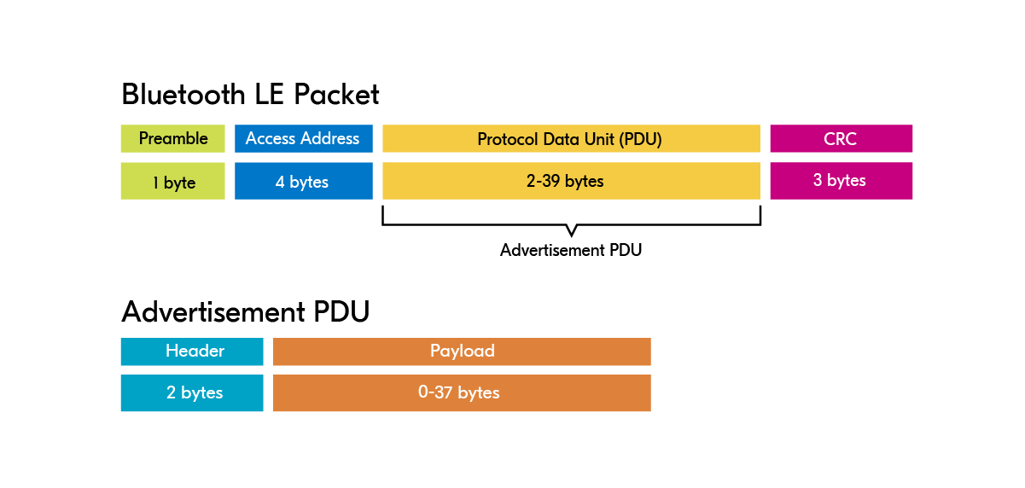
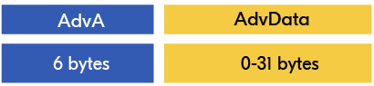
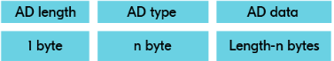
BLE packet structure
High level
BLE Packet
Advertisement PDU
Payload
Adv Data
Low level
Notes:
アドバタイジングではPDUに注目する。パケットは一定の構造に従ってる。
BLE packets follow a specific structure. When analyzing advertising packets, focus is placed on the PDU (Protocol Data Unit).
BLEは一定の構造に従ってる。
ADVとかが大事そうだ

Slide 11




Synthetic Data
Overview of synthetic data
How to generate synthetic data
What is synthetic data?
Synthetic data is artificial data created to mimic real-world data characteristics and structures.
Statistics
What are the benefits of synthetic data?
1
Unlimited data
Machine learning
2
No privacy issue
3
Reduce bias
4
Reduce time costs
Deep learning
5
Reduce monetary costs
Notes:
合成データとは何か、その目的
Synthetic data refers to artificially generated data that mimics the characteristics and structure of real-world data.

Slide 12
GAN has gotten attention as a method of generating synthetic data. There is the Hidden Markov Model, an advanced version of the Markov Model.
XXXX
XXXX
XXXX
XXXX
XXXX
XXXX
Notes:
合成データを作成する手法の説明。GAN、MM、HMM

Slide 13










GAN
How does GAN work
Pros and Cons
コロナ禍からの需要回復
Noise
Generator
Fake Data
Real
Discriminator
値上げによる客単価上昇
Real Data
Fake
訪日外国人の増加
13

Slide 14
Noise
Generator
Fake Data
Real
Discriminator
Real Data
Fake

Slide 15
Noise
Generator
Fake Data
Real
Discriminator
Real Data
Fake

Slide 16




0.5
0.4
0.5
0.1
0.5
0.1
0.3
0.4
Cloudy
Rainy
Sunny
0.2

Slide 17






0.5
0.7
0.0
0.3
Observable data
Hidden state
Shop
Walk
Clean
0.4
0.5
0.1
0.5
0.1
0.3
0.4
Cloudy
Rainy
Sunny
0.4
0.3
0.3
0.1
0.5
0.4
Shop
Walk
Clean
Shop
Walk
Clean
0.2

Slide 18
Stefan created a BLE dataset and classification model. While the accuracy of test data is high, the accuracy of real-world data is not as satisfactory.
What he did
Limitation
XXXX
XXXX
XXXX
XXXX
Notes:
Stefanの研究の説明。（何をしたのか、何が限界なのか）→だから合成データを作る

Slide 19

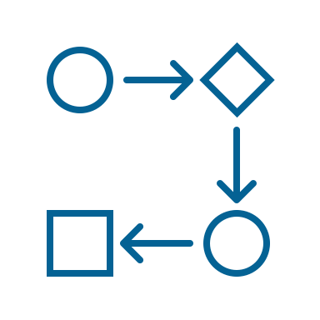
Previous studies were reviewed from two perspectives.
Relating to BLE
Creating of synthetic data using Markov model
XXXX
XXXX
XXXX
XXXX
XXXX
XXXX
Notes:
先行研究ではBLEパケットの合成に取り組んだ研究はなかった。→この研究には意味がある。

Slide 20
Overview of related works
Research
Synthesize BLE
packet data
Related
Markov model
Time series data
Can this be used to create synthetic BLE packets?
Synthesizing data
Simulation
Not Hidden
Hidden
Method
Data
1
No
Yes
No
No
No
Yes
No
Partially
2
No
Yes
No
No
No
Yes
No
Partially
3
No
No
Yes
No
No
Yes
No
Partially
4
No
No
Yes
No
No
Yes
No
Partially
5
No
Yes
No
No
No
Yes
No
Partially
6
No
Yes
No
Yes
No
Yes
Yes
No
7
No
Yes
No
Yes
No
Yes
Yes
No
8
No
Yes
No
Yes
No
Yes
Yes
No
9
No
Yes
No
No
Yes
Yes
No
No
10
No
Yes
No
No
Yes
No
No
No
11
No
Yes
No
No
Yes
No
No
No
This Research
Yes
Yes
No
Yes
No
Yes
Yes
Yes
Notes:
There are no existing studies that have focused on synthesizing BLE packet data. Markov Models are commonly used for synthesizing time-series data.

Slide 21
Executive Summary
Introduction
Background
Index
Design
Implimentation
Next Step

Slide 22
Given that BLE packet data has a defined structure and is time-series in nature, the Markov Model is chosen.
XXXX
XXXX
XXXX
XXXX
XXXX
XXXX
Notes:
BLEパケットデータは構造が決まっていることと、時系列データであることからマルコフモデルを選択する。

Slide 23
Generated synthetic data of preprocessed SmartTag (nearby) packet data.
XXXX
XXXX
XXXX
XXXX
XXXX
XXXX
Notes:
前処理済みのSmartTag(nearby)を合成する理由

Slide 24
Executive Summary
Introduction
Background
Index
Design
Implimentation
Next Step

Slide 25
Synthetic data was created using Python (3.12)
XXXX
XXXX
XXXX
XXXX
XXXX
XXXX
Notes:
Python (3.12)を用いて合成データを作成した。

Slide 26
Executive Summary
Introduction
Background
Index
Design
Implimentation
Next Step

Slide 27

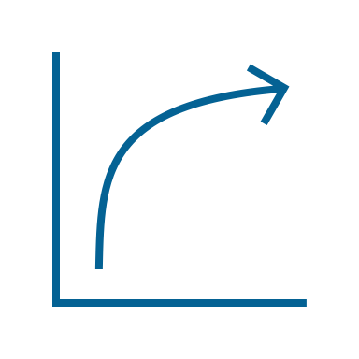
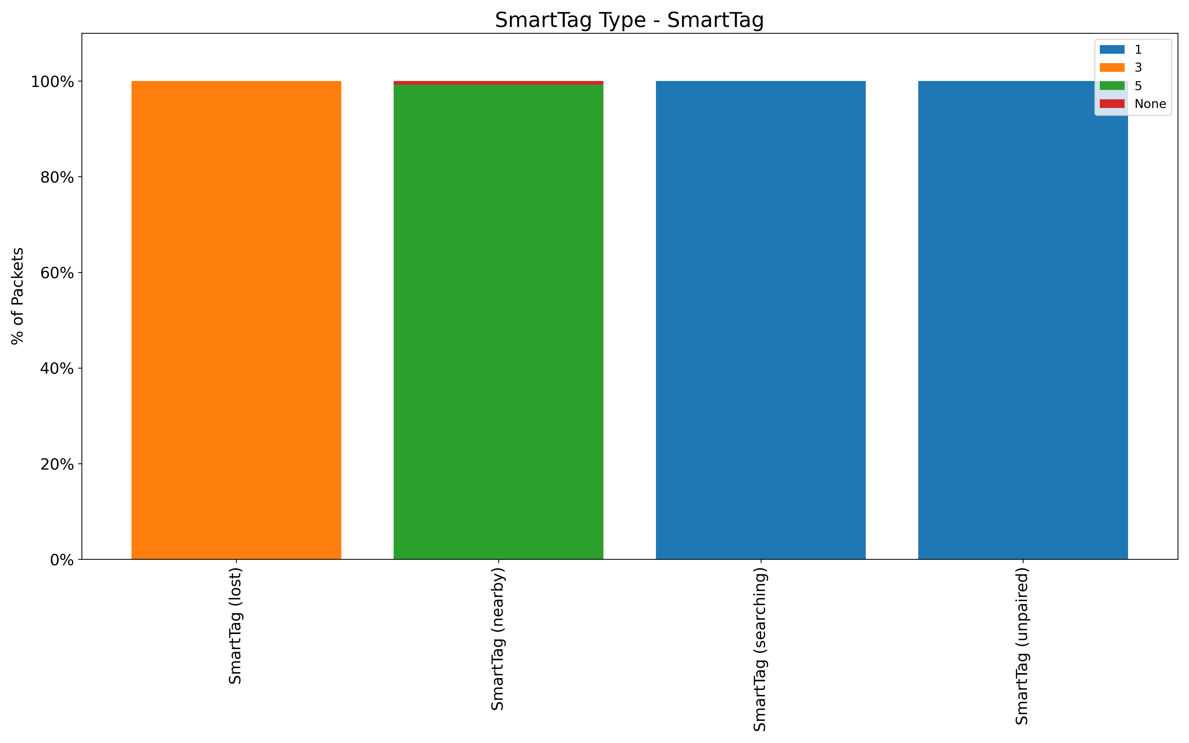
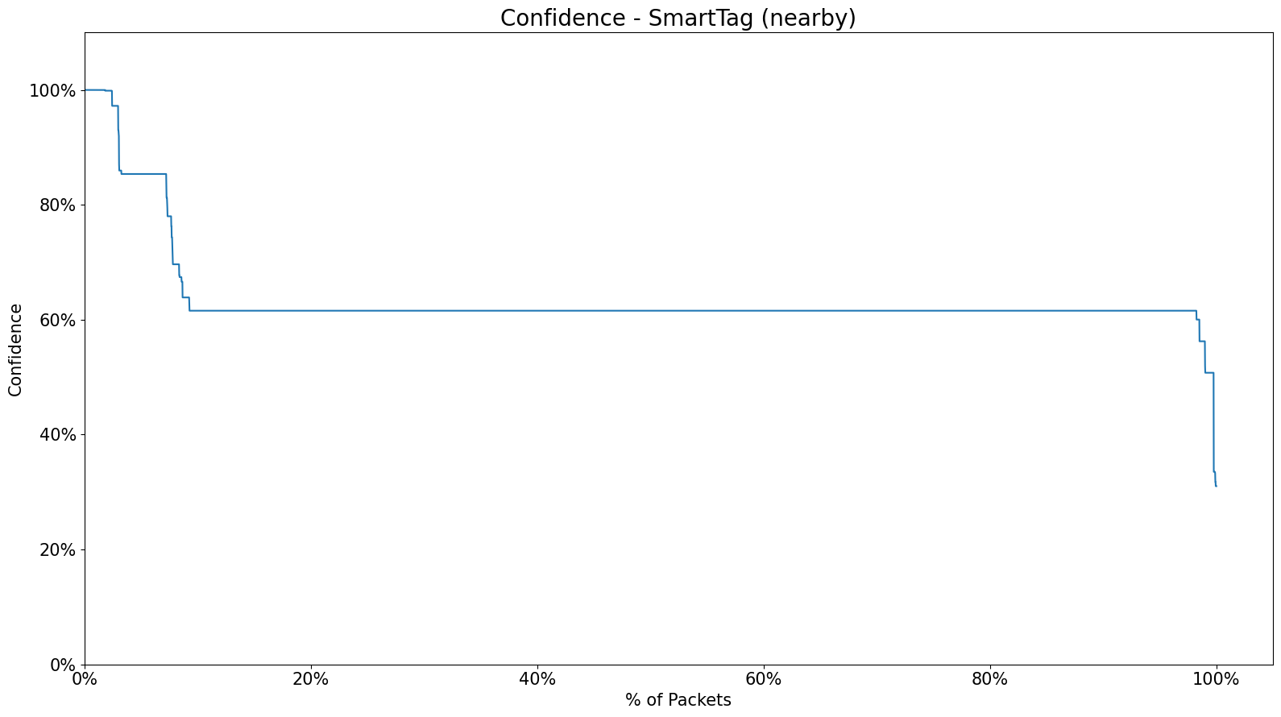
The next task is to evaluate the synthetic data. The evaluation will be conducted from two perspectives.
Data Structure
Confidence Lebel
Compare the structure of data with synthetic data and original data.
Compare confidence levels between models with and without synthetic data.
Stefan’s Github

